Slide 1
Agile & its Principles
- Atharva Puranik

Slide 2

What is Agile ?
Agile is a project management and software development methodology.
It emphasizes flexibility, collaboration, and iterative progress.
It focuses on delivering small, functional pieces of a project incrementally rather than delivering a complete product.

Slide 3
4 Manifesto of Agile
Individuals and interactions over processes and tools.
Working software over comprehensive documentation.
Customer collaboration over contract negotiation.
Responding to change over following a plan

Slide 4

Individuals and interactions over processes and tools.
People and communication are more important than strictly following processes or relying on tools.
Ex. A developer asks a teammate for help directly instead of relying solely on a tracking tool.

Slide 5

Working software over comprehensive documentation
Focuses more on developing ( coding) rather than making documentations.
The team delivers a functional app prototype rather than writing a lengthy specification document.

Slide 6

Customer collaboration over contract negotiation.
The team adjusts the project scope based on the customer's feedback, even after the project has started.

Slide 7

Responding to change over following a plan
The team shifts priorities to accommodate a new feature request instead of sticking rigidly to the original plan.

Slide 8
12 Principles of Agile
Individuals over Processes
Working Software over Comprehensive Documentation
Customer Collaboration over Contract Negotiation
Responding to Change over Following a Plan
Continuous Delivery
Welcome Changing Requirements
Self-Organizing Teams
Sustainable Development
Technical Excellence
Simplicity
Teamwork
Regular Reflection

Slide 9
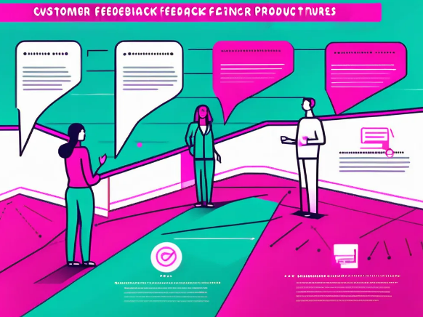
Customer satisfaction through early and continuous delivery of valuable software The team delivers a new feature every two weeks based on customer feedback.

Slide 10

Welcome changes The team adds a new feature requested by the customer during the final stages of development.

Slide 11

Deliver working software frequently, with a preference for shorter timescales The team releases a software update every month instead of waiting a year for a big launch.

Slide 12

Business people and developers must work together daily throughout the project The product manager joins daily stand-up meetings to align business goals with development progress.

Slide 13

Build projects around motivated individuals, and trust them to get the job done The team is given the freedom to decide the best way to develop the product with minimal oversight.

Slide 14

Face-to-face conversation A quick video call replaces long email discussions to resolve a critical issue.

Slide 15
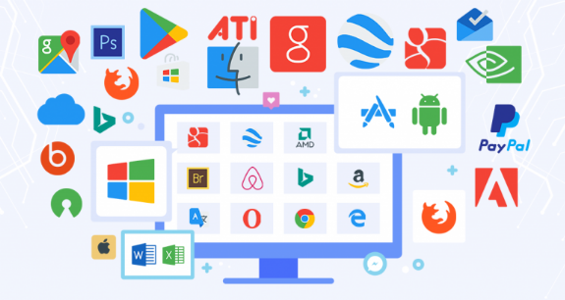
Working software is the primary measure of progress The team focuses on delivering functional features, not just writing documentation.

Slide 16

sustainable development The team sets a manageable workload, ensuring they can maintain steady progress without burning out.

Slide 17
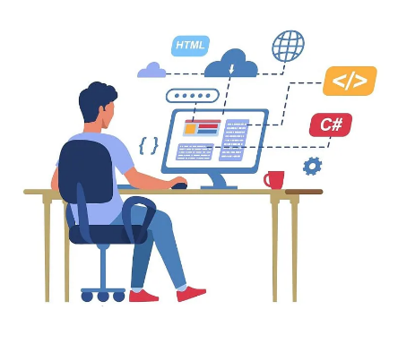
Continuous attention to technical work The team regularly improves code quality through refactoring to make future changes easier.

Slide 18

Simplicity The team removes unnecessary features and focuses only on what adds value.

Slide 19

self-organizing teams Developers and testers collaborate directly to design and implement features without waiting for management.

Slide 20
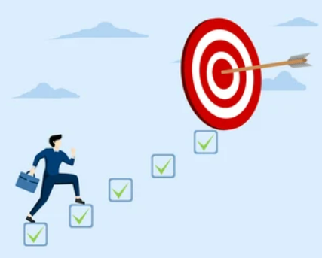
The team regularly reflects on how to become more effective and adjusts accordingly After each sprint, the team reviews what worked and what didn’t, then makes changes for the next cycle.

